Slide 1


2026 Canadian Nonprofit Sector Salary & Benefits Study
Highlights Webinar
June 4, 2026

Slide 2

Today’s Agenda
About The Portage Group
Study Overview
Who Participated?
Study Highlights
How to Use the Compensation Benchmarks
Making the Case in 2026!
Q & A

Slide 3
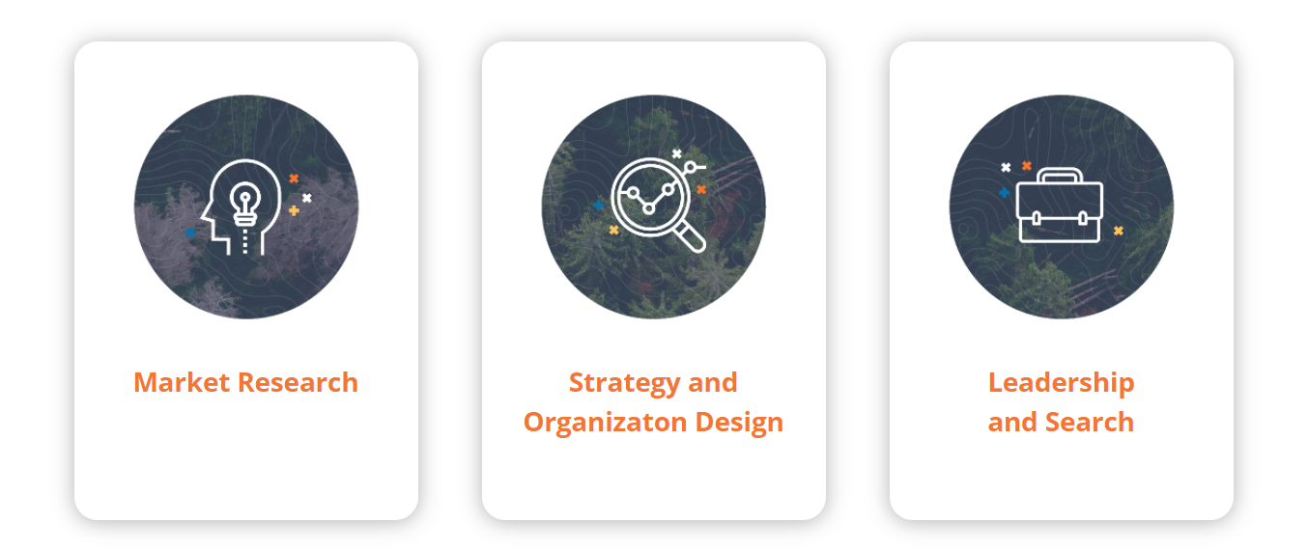
About The Portage Group
Full-service management consulting company focused on the not-for-profit sector.
Core Services:
Extensive experience conducting compensation studies.

Slide 4
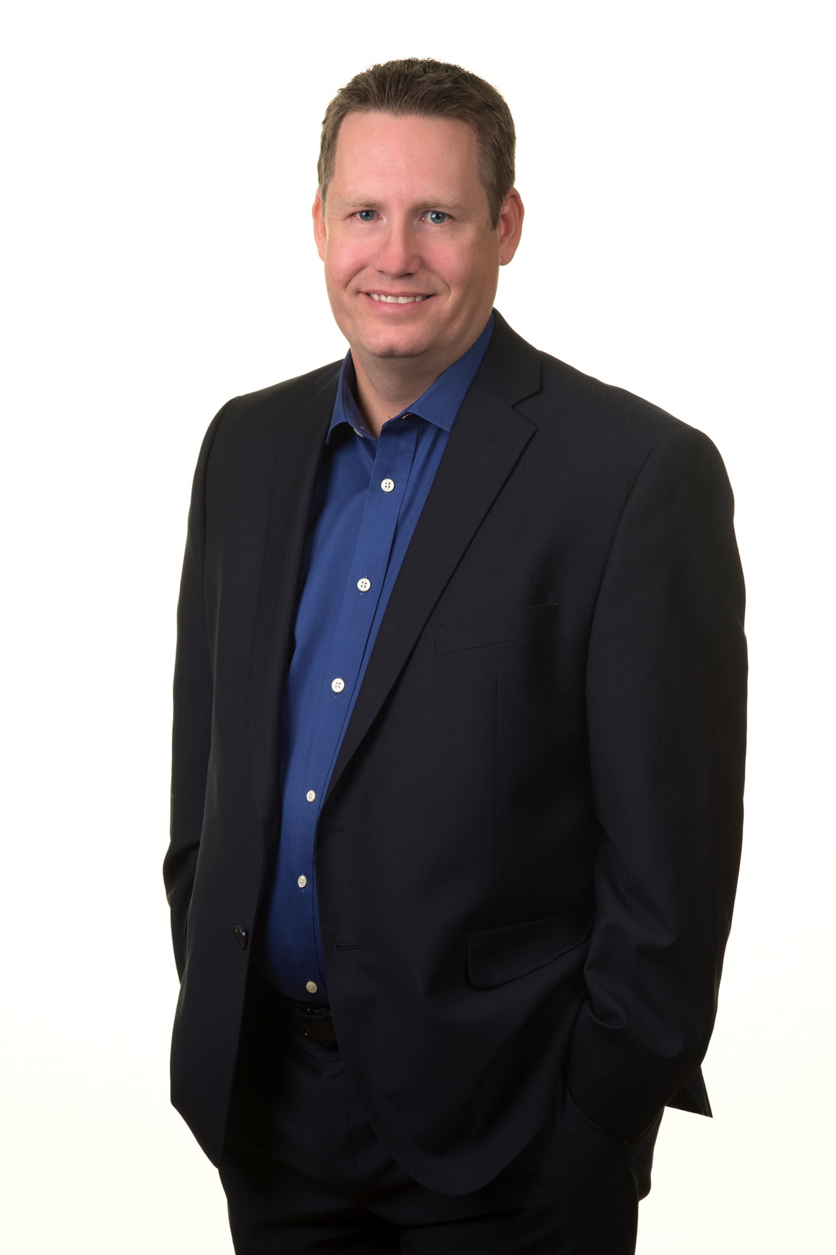
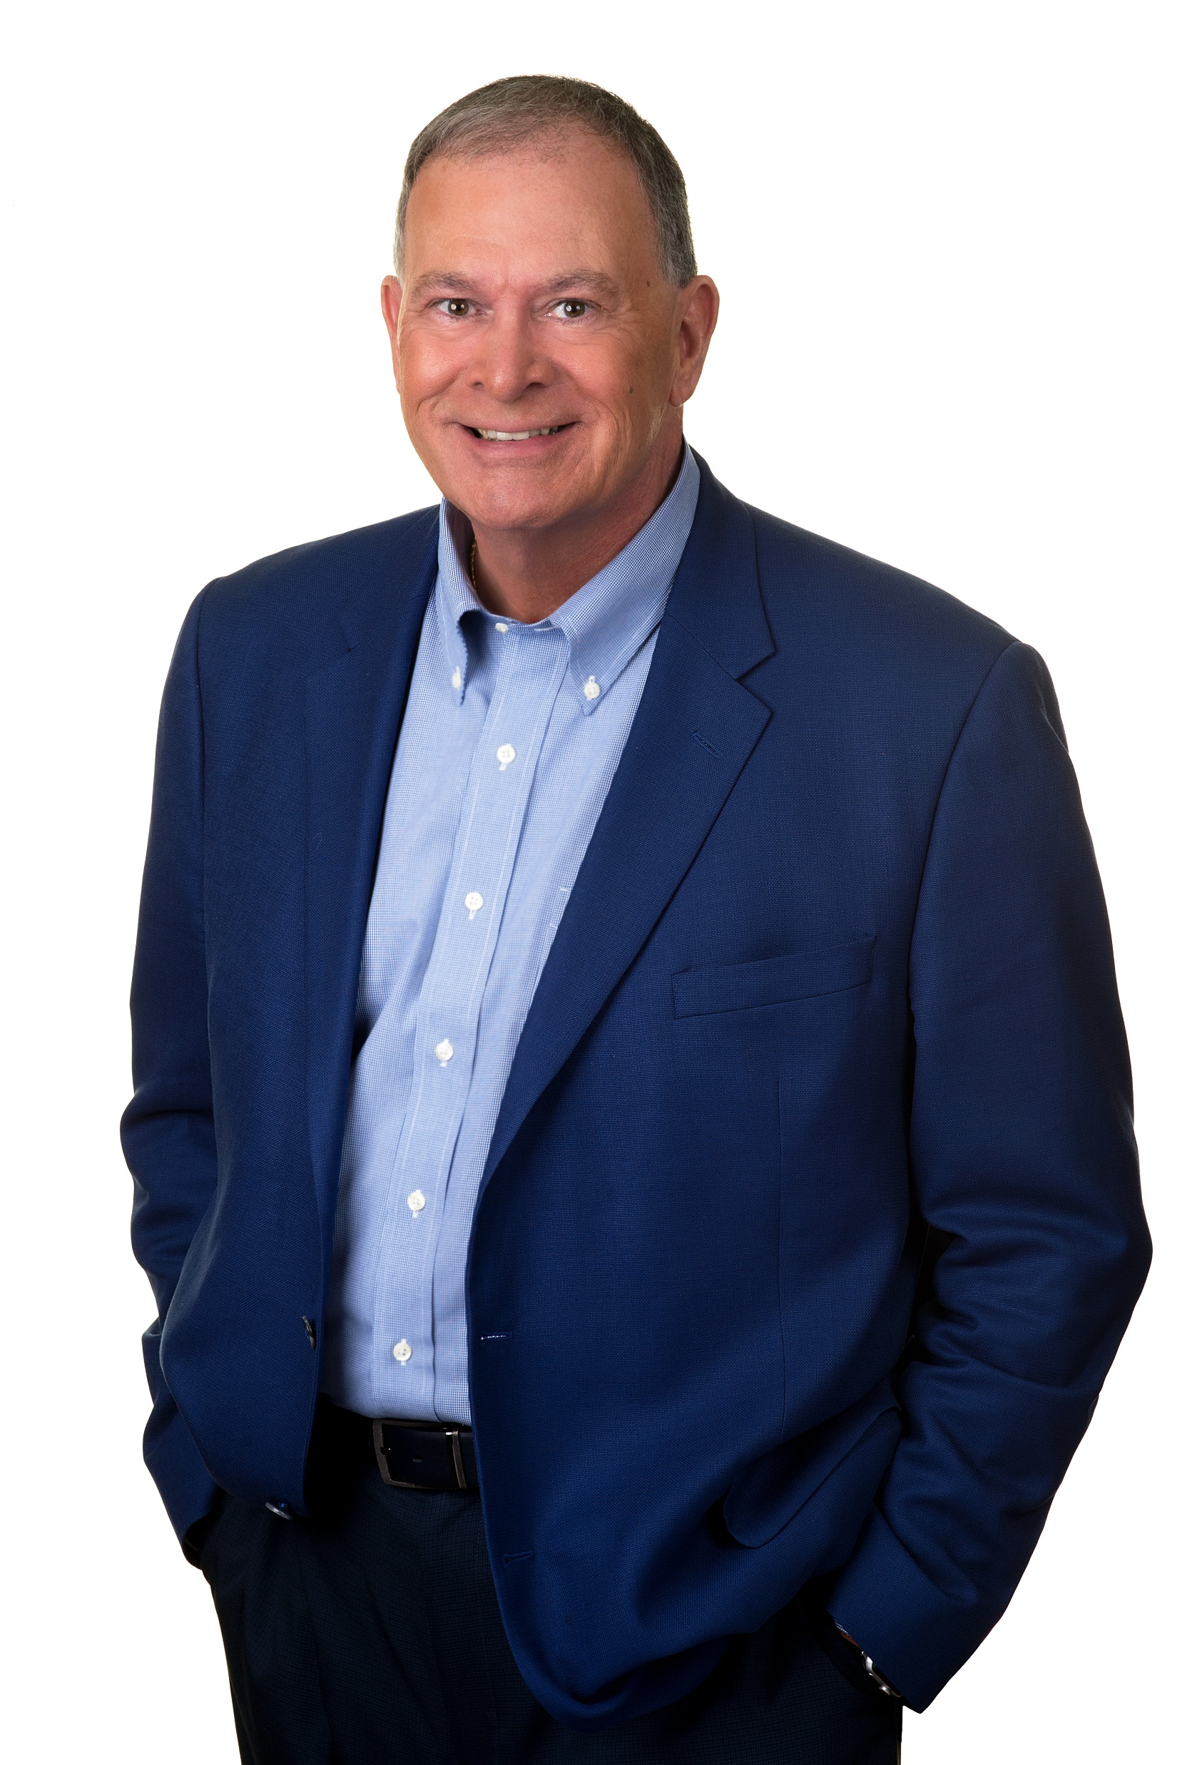
About the Presenters
Geoffrey Thacker, Executive Partner
Jack Shand, Practice Lead, Executive Search
Senior consulting roles with Association Resource Centre and co-founder of The Portage Group
Leads TPG’s research practice.
Over 30 years experience leading, designing and conducting market research – the last 25 years have been focused on associations and nonprofits
Senior consulting roles with Association Resource Centre, Leader Quest and, since 2014, The Portage Group
Practice focus includes executive search & leadership consulting for many types of NFPs – associations, charities, regulators, unions, etc.
Has led over 50 compensation studies in the nonprofit sector including all 11 of CharityVillage’s studies
Served in a management role in PricewaterhouseCoopers’ Measurement & Market Research practice
Fellow of the management consulting profession (FCMC)
CEO of three national organizations in the NFP sector prior to consulting
Volunteer roles have included management education (university committee chair), health charity (national fundraising chair), to community level NFPs (board director)

Slide 5
Study Overview
924 not-for-profit organizations participated in February and March 2026
Total of 4,508 staff position profiles in six levels:
  649 - Level 1: Chief Executive
  306 - Level 2: Senior Executive
  645 - Level 3: Senior Management
  919 - Level 4: Management/Supervisory Staff
  1,458 - Level 5: Functional & Program Staff
  531 - Level 6: Support Staff
Total of 11,182 individual staff represented
Study covers both compensation and benefits

Slide 6
Study Limitations
Compensation figures are as of February 2026.
Results are based on survey responses and are only as accurate as the data provided by survey participants.
Survey was not random. Accordingly, it may or may not be an accurate representation of the total of the nonprofit sector in Canada.
Interpret smaller segment data with caution due to small sample sizes.

Slide 7
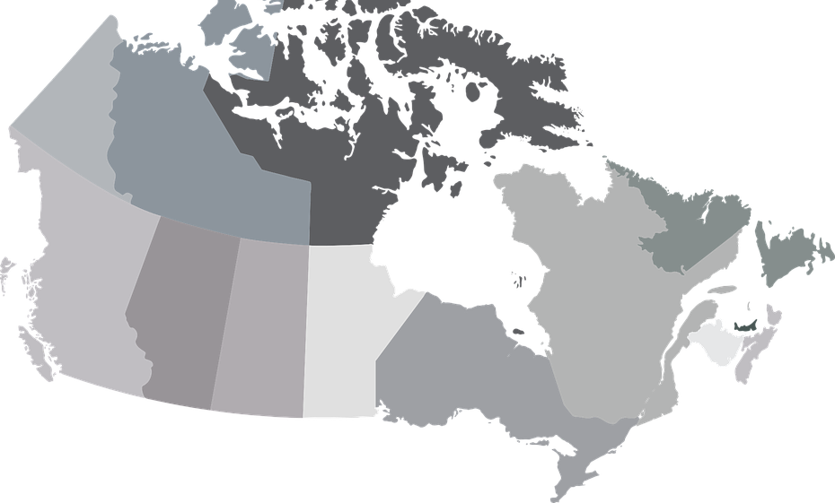
Who Participated?
BC
22%
Quebec
2%
Atlantic
4%
Prairies
6%
Alberta
14%
Ontario
52%
Number of Staff
Budget

Slide 8

Study Highlights

Slide 9
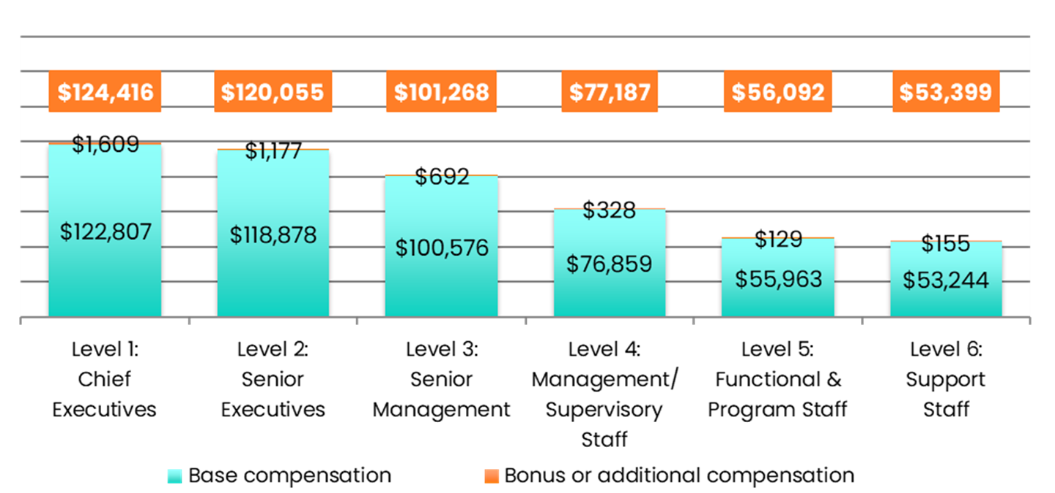
Cash Compensation by Level

Slide 10
Bonus Compensation by Level
Average Amount of Bonus Cash Compensation (% of base compensation)
 | Level 1 | Level 2 | Level 3 | Level 4 | Level 5 | Level 6
Among all staff | 0.8% | 0.8% | 0.6% | 0.4% | 0.2% | 0.3%
Among those who receive bonus pay | 6.0% | 5.7% | 5.1% | 3.2% | 2.8% | 3.6%

Slide 11
Change in Cash Compensation by Level 2016 to 2026

Slide 12
How Do Pay Increases Stack Up Over Time
Note: Base is February 2013.
*No study in these years, increases were estimated based on the annual growth rate between studies.

Slide 13
Salaries and Wages vs. Inflation Since Pandemic (past 5 years)
Note: Base is February 2020.
*No study in these years, increases were estimated based on the annual growth rate between studies.

Slide 14
Average Change in Compensation
Past 12 Months
Expected in Next 12 Months

Slide 15
How to Use the Benchmarks

Slide 16
How to Use the Benchmarks
Step 1: Establish the Position Profile
Organization Characteristics
Personal Characteristics
Organization Type = Registered Charity
Location = BC
Jurisdiction = Local
Budget = $1,250,000
Number of Staff = 7
Affiliation = None
Position = Chief Executive
Status = Full-time
Experience in discipline = 8 years
Education = Bachelor’s degree
Remote Work Status = Hybrid

Slide 17
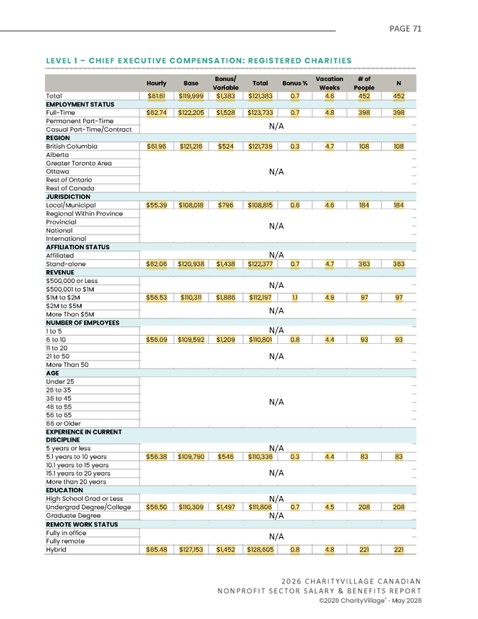
How to Use the Benchmarks
Step 2: Identify Your Benchmark Categories – Organization Type
Organization Type: Registered Charity
Region: BC
Jurisdiction: Local
Budget: $1 million to $2 million
Number of Staff: 6 to 10
Affiliation: None
Position: Chief Executive
Status: Full-time
Experience in discipline: 5.1 to 10 years
Education: Undergraduate Degree
Remote Work Status: Hybrid

Slide 18
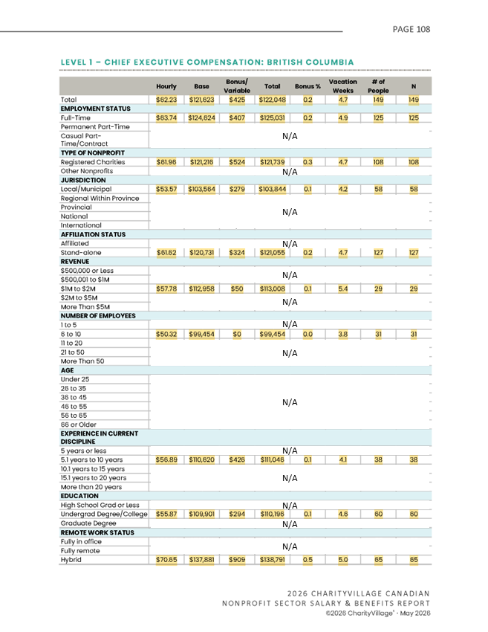
How to Use the Benchmarks
Step 2: Identify Your Benchmark Categories - Region
Region: BC
Organization Type: Registered Charity
Jurisdiction: Local
Budget: $1 million to $2 million
Number of Staff: 6 to 10
Affiliation: None
Position: Chief Executive
Status: Full-time
Experience in discipline: 5.1 to 10 years
Education: Undergraduate Degree
Remote Work Status: Hybrid

Slide 19
How to Use the Benchmarks
Step 3: Summarize Your Benchmarks
Registered Charity Benchmarks
 | Base Salary | Bonus | Total Cash | Avg. Bonus % | N
2026 Total Registered Charity | $119,999 | $1,383 | $121,383 | 0.7 | 452
BC | $121,216 | $524 | $121,739 | 0.3 | 108
Local | $108,018 | $796 | $108,815 | 0.6 | 184
Stand-alone | $120,938 | $1,438 | $122,377 | 0.7 | 363
$1M to $2M | $110,311 | $1,886 | $112,197 | 1.1 | 97
6 to 10 staff | $109,592 | $1,209 | $110,801 | 0.8 | 93
5.1 years to 10 years | $109,790 | $546 | $110,336 | 0.3 | 83
Undergraduate Degree | $110,309 | $1,497 | $111,806 | 0.7 | 208
Hybrid | $127,153 | $1,452 | $128,605 | 0.8 | 221
BC Benchmarks
 | Base Salary | Bonus | Total Cash | Avg. Bonus % | N
2026 BC | $121,623 | $425 | $122,048 | 0.2 | 149
Registered Charities | $121,216 | $524 | $121,739 | 0.3 | 108
Local | $103,564 | $279 | $103,844 | 0.1 | 58
Stand-alone | $120,731 | $324 | $121,055 | 0.2 | 127
$1M to $2M | $112,958 | $50 | $113,008 | 0.1 | 29
6 to 10 staff | $99,454 | $0 | $99,454 | 0.0 | 31
5.1 years to 10 years | $110,620 | $426 | $111,046 | 0.1 | 38
Undergraduate Degree | $109,901 | $294 | $110,196 | 0.1 | 60
Hybrid | $137,881 | $909 | $138,791 | 0.5 | 65

Slide 20
How to Use the Benchmarks
Step 4: Consider Quartiles and Choose Data Points
Registered Charity Benchmarks
 | Base Salary | Bonus | Total Cash | Avg. Bonus % | N
2026 Total Registered Charity | $119,999 | $1,383 | $121,383 | 0.7 | 452
BC | $121,216 | $524 | $121,739 | 0.3 | 108
Local | $108,018 | $796 | $108,815 | 0.6 | 184
Stand-alone | $120,938 | $1,438 | $122,377 | 0.7 | 363
$1M to $2M | $110,311 | $1,886 | $112,197 | 1.1 | 97
6 to 10 staff | $109,592 | $1,209 | $110,801 | 0.8 | 93
5.1 years to 10 years | $109,790 | $546 | $110,336 | 0.3 | 83
Undergraduate Degree | $110,309 | $1,497 | $111,806 | 0.7 | 208
Hybrid | $127,153 | $1,452 | $128,605 | 0.8 | 221
1st Quartile | 2nd Quartile | 3rd Quartile | 4th Quartile | 95th Percentile
< $85,000 | $85,000 to $106,400 | $106,400 to $144,100 | $144,100 + | $220,700

Slide 21
How to Use the Benchmarks
Step 4: Consider Quartiles and Choose Data Points
BC Benchmarks
 | Base Salary | Bonus | Total Cash | Avg. Bonus % | N
2026 BC | $121,623 | $425 | $122,048 | 0.2 | 149
Registered Charities | $121,216 | $524 | $121,739 | 0.3 | 108
Local | $103,564 | $279 | $103,844 | 0.1 | 58
Stand-alone | $120,731 | $324 | $121,055 | 0.2 | 127
$1M to $2M | $112,958 | $50 | $113,008 | 0.1 | 29
6 to 10 staff | $99,454 | $0 | $99,454 | 0.0 | 31
5.1 years to 10 years | $110,620 | $426 | $111,046 | 0.1 | 38
Undergraduate Degree | $109,901 | $294 | $110,196 | 0.1 | 60
Hybrid | $137,881 | $909 | $138,791 | 0.5 | 65
1st Quartile | 2nd Quartile | 3rd Quartile | 4th Quartile | 95th Percentile
< $90,000 | $90,000 to $110,000 | $110,000 to $137,500 | $137,500 + | $233,400

Slide 22
How to Use the Benchmarks
Step 5: Set Range
The report data is a guideline only.
You should consider other factors such as the cost to replace staff and the current labour market.
The greatest weight should be given to the closest or most relevant comparables.
There is no one correct approach.

Slide 23
How to Use the Benchmarks
Step 5: Set Range
Common Approach 1: Select High and Low
  High = Hybrid (BC): $138,791
  Low = 6 to 10 staff (BC) - $99,454
Range would be $99,500 to $138,800
Mid point is $119,123 (($99,454+$138,791)/2)
Registered Charity Benchmarks
 | Total Cash
2026 Total Registered Charity | $121,383
BC | $121,739
Local | $108,815
Stand-alone | $122,377
$1M to $2M | $112,197
6 to 10 staff | $110,801
Hybrid | $128,605
ALT. HIGH
BC Benchmarks
 | Total Cash
2026 BC | $122,048
Registered Charities | $121,739
Local | $103,844
Stand-alone | $121,055
$1M to $2M | $113,008
6 to 10 staff | $99,454
Hybrid | $138,791
ALT. LOW
Alternate Approach (drop high and low)
Range: $103,800 to $128,600
Mid point: $116,200
LOW
HIGH

Slide 24
How to Use the Benchmarks
Step 5: Set Range
Common Approach 2: Benchmark Average ±X%
  Assume desired range is 10%
  Average of benchmarks is $117,600 (rounded)
  Desired variance is ± $11,760 ($117,600 X 10%, rounded)
  Upper Limit = $129,360 ($117,600 + $11,760)
  Lower Limit = $105,840 ($117,600 - $11,760)
Range would be $105,800 to $129,400
Mid point is $117,600
Registered Charity Benchmarks
 | Total Cash
2026 Total Registered Charity | $121,383
BC | $121,739
Local | $108,815
Stand-alone | $122,377
$1M to $2M | $112,197
6 to 10 staff | $110,801
Hybrid | $128,605
GTA Benchmarks
 | Total Cash
2026 BC | $122,048
Registered Charities | $121,739
Local | $103,844
Stand-alone | $121,055
$1M to $2M | $113,008
6 to 10 staff | $99,454
Hybrid | $138,791
Avg. $117,561

Slide 25
How to Use the Benchmarks
Step 5: Set Range
Avg. Reg. Charity $117,988
Common Approach 3: Average of Category Averages ±X%
  Assume desired range is 10%
  Average of category benchmarks is $117,600 (rounded [($117,988+$117,134)/2])
  Variance is ± $11,760 ($117,600 X 10%)
  Upper Limit = $129,360 ($117,600 + $11,760)
  Lower Limit = $105,840 ($117,600 - $11,760)
Range would be $105,800 to $129,400
Mid point is $117,600
Registered Charity Benchmarks
 | Total Cash
2026 Total Registered Charity | $121,383
BC | $121,739
Local | $108,815
Stand-alone | $122,377
$1M to $2M | $112,197
6 to 10 staff | $110,801
Hybrid | $128,605
GTA Benchmarks
 | Total Cash
2026 BC | $122,048
Registered Charities | $121,739
Local | $103,844
Stand-alone | $121,055
$1M to $2M | $113,008
6 to 10 staff | $99,454
Hybrid | $138,791
Average of Category Benchmark $117,561
Avg. BC $117,134

Slide 26

Making the Case for Compensation Growth in the Non-Profit Sector
Balancing Impact, Stewardship, and Retention

Slide 27
Context - Today’s Focus
Understanding the current environment
Building a credible compensation case
Thinking beyond salary: Alternatives to salary in constrained environments
Practical actions you can take immediately

Slide 28
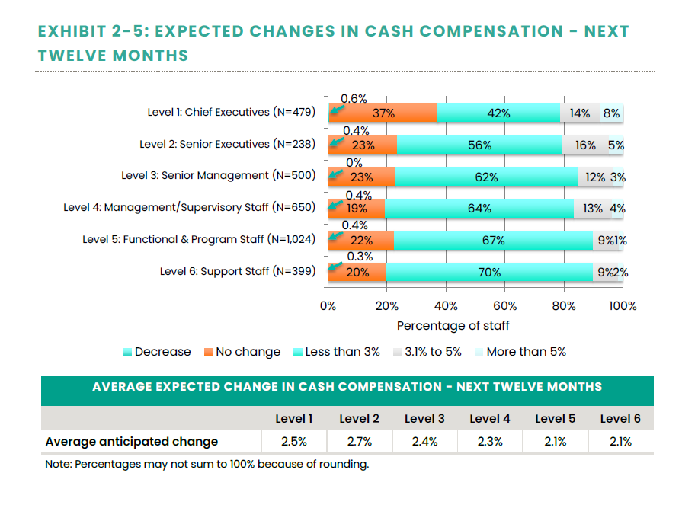
Context - Sector Reality | The 2026-27 Environment
Increases of ≈2½ % = cost of living
Budget constraints and funding pressures
Greater Board scrutiny of compensation decisions
Increased focus on retention and development

Slide 29

Top Workforce Trends Shaping Compensation in 2026-2027
Retention remains more important than recruitment
Skills are increasingly valued over tenure
Employees expect development, not just pay
Flexibility remains a highly valued benefit
Career growth is becoming a retention strategy
Notes:
iStock purchase (LQ 2026)

Slide 30
What Employers Are Most Willing to Invest In
Leadership development
Specialized skills and certifications
Internal succession
Employee engagement and retention
Future organizational capacity

Slide 31

Key Shift
From Personal Request → Mission-Aligned Business Case
Align with mission
Demonstrate value
Show organizational
awareness
Notes:
Adobe sub purchased #7250888

Slide 32

Build Your Case
Quantify Impact
Demonstrate outcomes
Clear before & after examples!
Connect results to mission

Slide 33
Strengthen Your Position
Use market data appropriately
Understand organizational constraints
Consider timing (e.g., align with budget cycle)
Demonstrate stewardship

Slide 34

Think Forward
Future contribution
Performance-linked approaches
Total rewards mindset

Slide 35
Make It Easy to Say Yes
Clear rationale
Specific request
Evidence-based discussion
Alignment with priorities

Slide 36
If the Answer is ‘Not Now’
Seek feedback
Clarify expectations
Establish a timeline
Explore alternatives

Slide 37

Beyond Salary…High-Value Alternatives
Training and certifications
Stretch assignments
Formal mentorship

Slide 38

Career Acceleration Opportunities
External visibility
Strategic projects
Innovation opportunities

Slide 39

Long-Term Value
Career path clarity
Flexibility
Development investments
Sustainability

Slide 40

Monitor The Market
Major studies on compensation increases for 2027 will be coming in late summer and Fall 2026
Normandin Beaudry, Gallagher
Major banks & consulting firms
Conference Board of Canada
Economists and
Economic news (e.g., inflation, recession, unemployment)

Slide 41

Final Thought
In the charitable | NFP sector
Impact Justifies Investment
Mission drives decisions
Stewardship shapes compensation
Retention
Growth

Slide 42







Thank You!
Contact Info
Geoffrey Thacker
Executive Partner
gthacker@portagegroup.com
Jack Shand
Practice Lead, Executive Search
jshand@portagegoup.com
www.portagegroup.com
https://www.linkedin.com/company/portagegroup
https://www.facebook.com/HelpingAssociations
@ThePortageGroup
Notes:
Image from AdobeStock: AdobeStock_550885061

